Slide 1

Notes:
Hello, Most of you are already aware that I am a big Harry potter fan so when we were told to do an individual project my hands itched for Harry potter dataset. Ohh sorry my excitement for harry potter !! Let’s me just take a breathe. Before I begin for my colleagues who do not have any idea about Harry Potter let me just start from begining

Slide 2
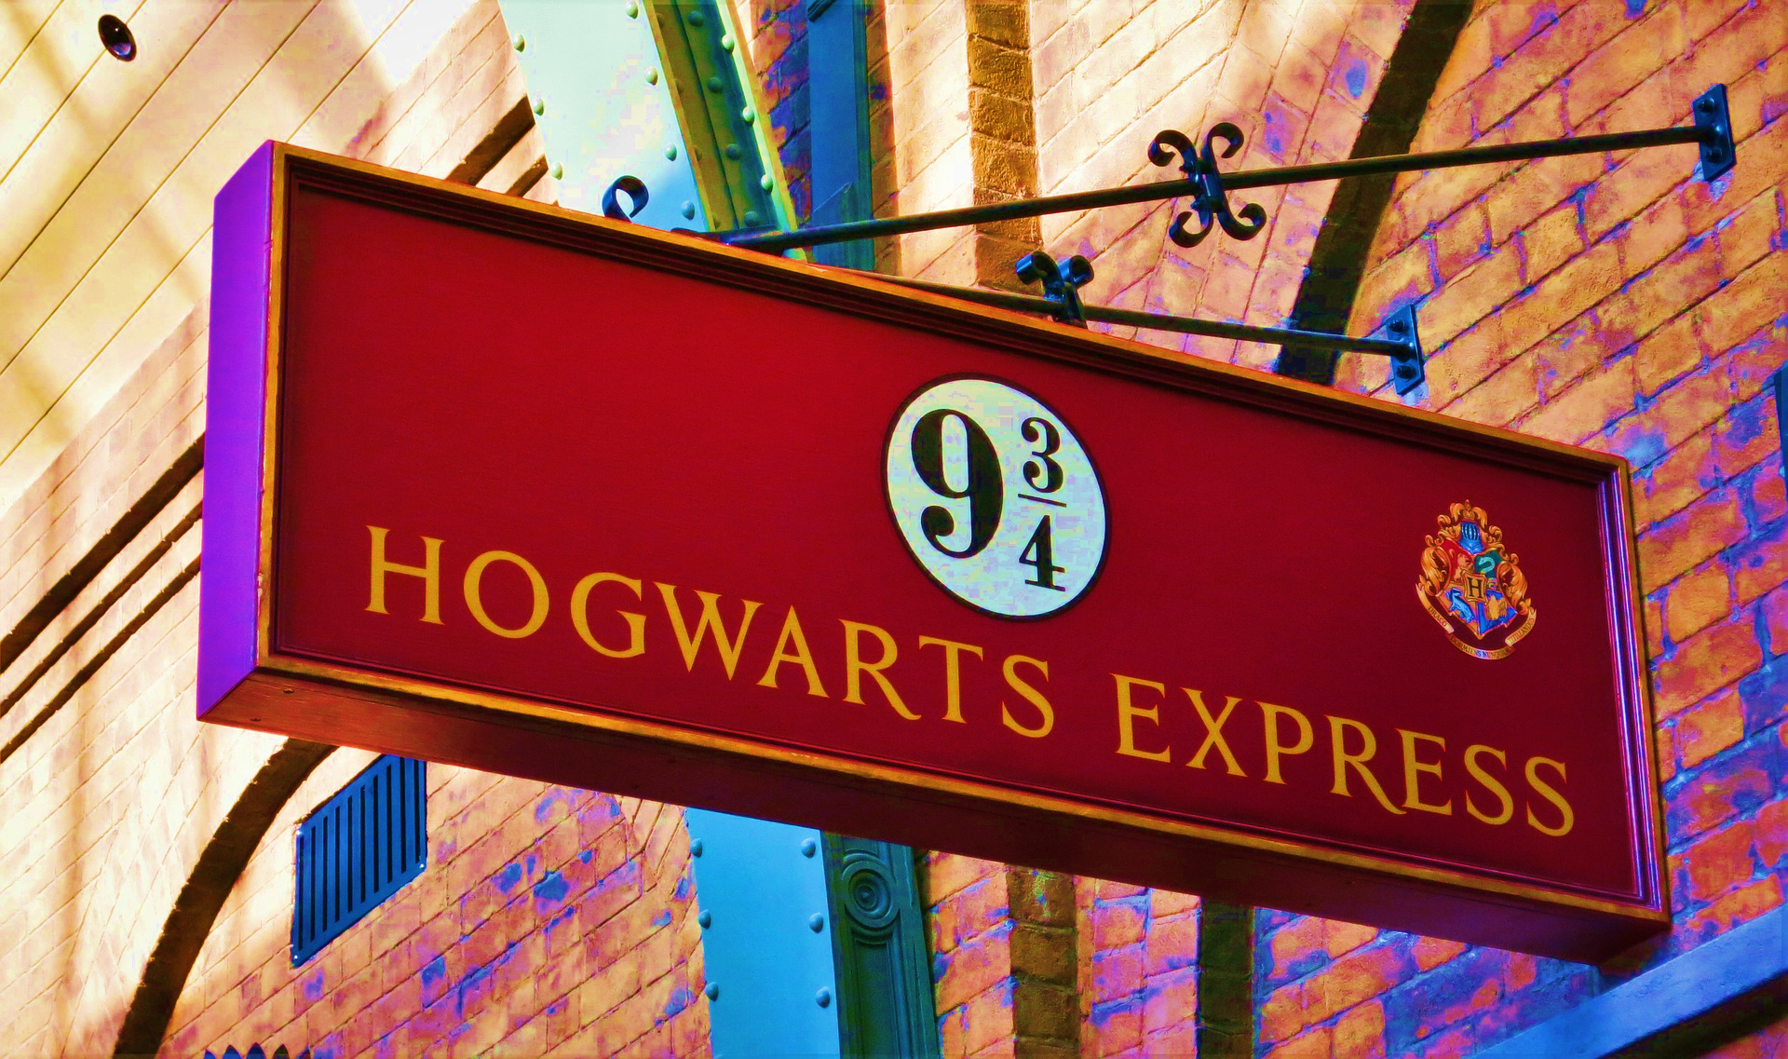
WE ARE RIGHT NOW IN FOR AN EXCITING MAGICAL JOURNEY
Notes:
Guys and gals we are right now in for an exciting magical journey

Slide 3
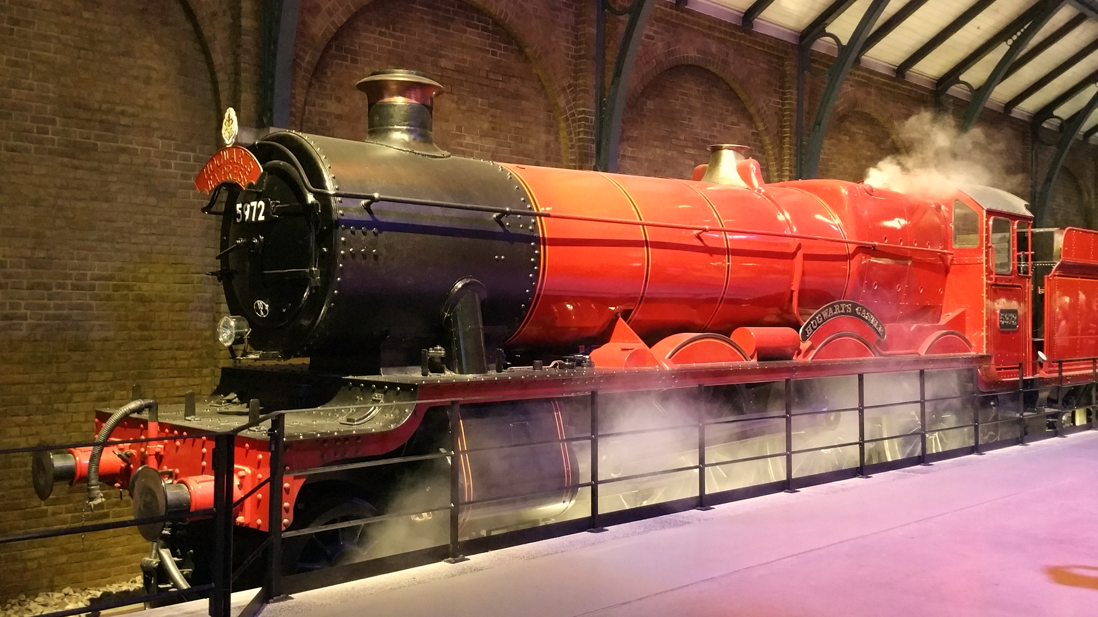
LET’S HOP ON THE TRAIN AND START THE RIDE

Slide 4

TO
THE SCHOOL OF MAGIC
This Photo by Unknown Author is licensed under CC BY-NC-ND

Slide 5
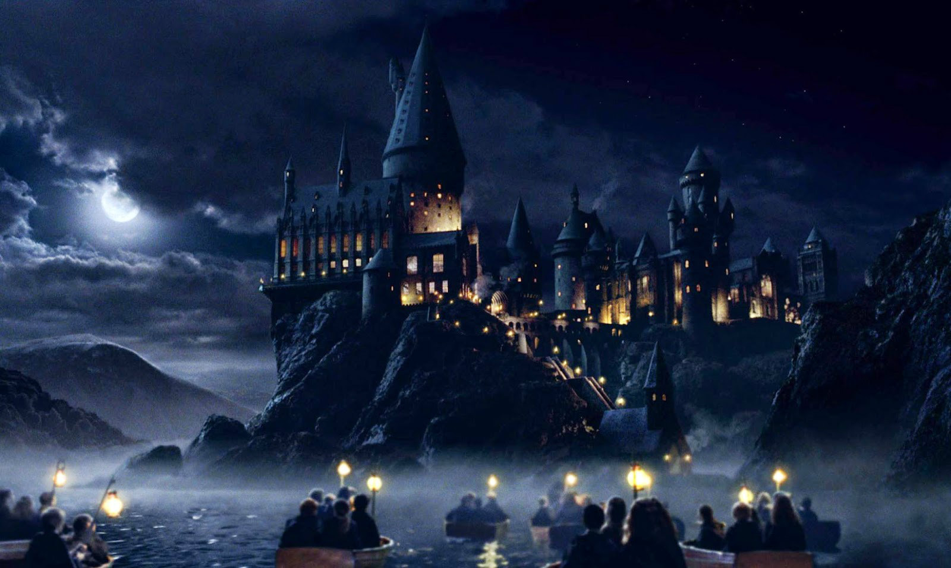
HOGWARTS
Notes:
Where you will meet the

Slide 6
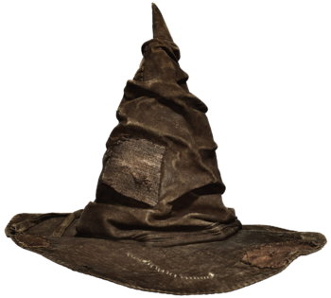
SORTING HAT
Notes:
Which will sort you to respective houses

Slide 7




HOUSES
SLYTHERIN
GRYFFINDOR
RAVENCLAW
HUFFLEPUFF
Notes:
Houses being Slytherin… Well and these houses are known for their special traits

Slide 8
"Slytherin will help you on your way to greatness".
MEANING
LEADERS
GRYFFINDOR
RAVENCLAW
HUFFLEPUFF
SLYTHERIN
Notes:
Slytherin vouches that it will help you on your way to greatness

Slide 9
"Gryffindor, where dwell the brave at heart!".
MEANING
COURAGEOUS
SLYTHERIN
RAVENCLAW
HUFFLEPUFF
GRYFFINDOR
Notes:
Gryffindor is where dwell the brave at heart `meaning courageous . Further, all our main character are in this house making it a hotshot house

Slide 10
"Wit beyond measure is man's greatest treasure".
MEANING
WISE
SLYTHERIN
GRYFFINDOR
RAVENCLAW
HUFFLEPUFF
Notes:
Ravenclaw believes that wit beyond measure is man’s greatest treasure.

Slide 11
Hufflepuffs are true, and unafraid of toil.
MEANING
HARDWORKERS
SLYTHERIN
GRYFFINDOR
RAVENCLAW
HUFFLEPUFF

Slide 12





RANKINGS
Notes:
In terms of movie and book this is how my personal ranking goes : Winner being obviously – Gryffindor and the last place goes to slytherin

Slide 13

REAL WORLD
Notes:
But we live in the real world ,we are data analyst and for us statistics, graphs, datasets, analysis are really important. So here comes my datasets I took the dialogue of each harrypotter character and then connected to an api and passed them on to a real analyser called IBM Watson personality insight

Slide 14
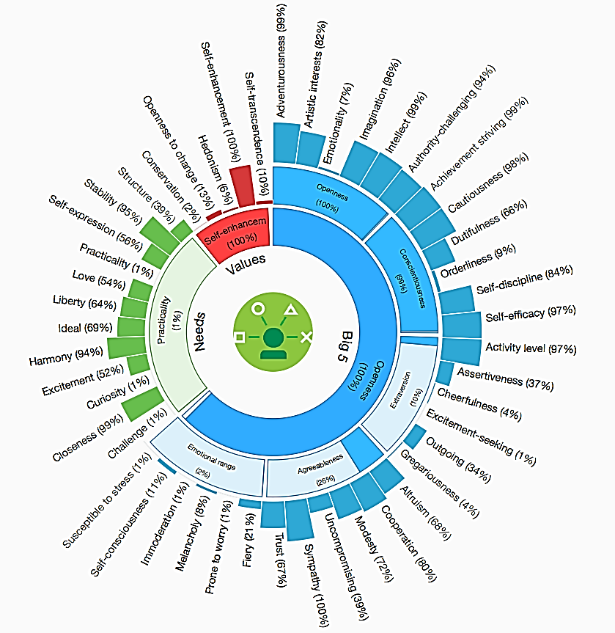
IBM WATSON PERSONALITY INSIGHTS
BIG5
VALUES
NEEDS
Notes:
This analyser measures your big5 personality,your values and your needs. But today I will just talk about Big5 personality. Big 5 as the name suggest measures five traits

Slide 15
BIG5
AGREEABLENESS
CONSCIENTIOUSNESS
EXTRAVERSION
NEUROTICISM
OPENNESS
Notes:
Agreeableness meaning compassion, respectfulness, trust in others
Conscientiousness meaning organization, productiveness, responsibility
Extraversion meaning sociability, assertiveness;
Neuroticism tendencies toward anxiety and depression
Openness includes aspects such as intellectual curiosity and creative imagination. So next question will be how does it work

Slide 16

HOW DOES IT WORKS ?
DATA
WRITING STYLE
POSTING STYLE
DIALOGUE STYLE
WORD
COUNT >100
MY DATASET:
THE MOVIE SCRIPT
PERSONALITY NSIGTHS
Notes:
The analyser takes data in terms of what you write , what you post , what you say process it and tell you about personality.
But the word count should be more than 100 . My dataset was the harry potter movie script. I took the average big5 score for each houses

Slide 17
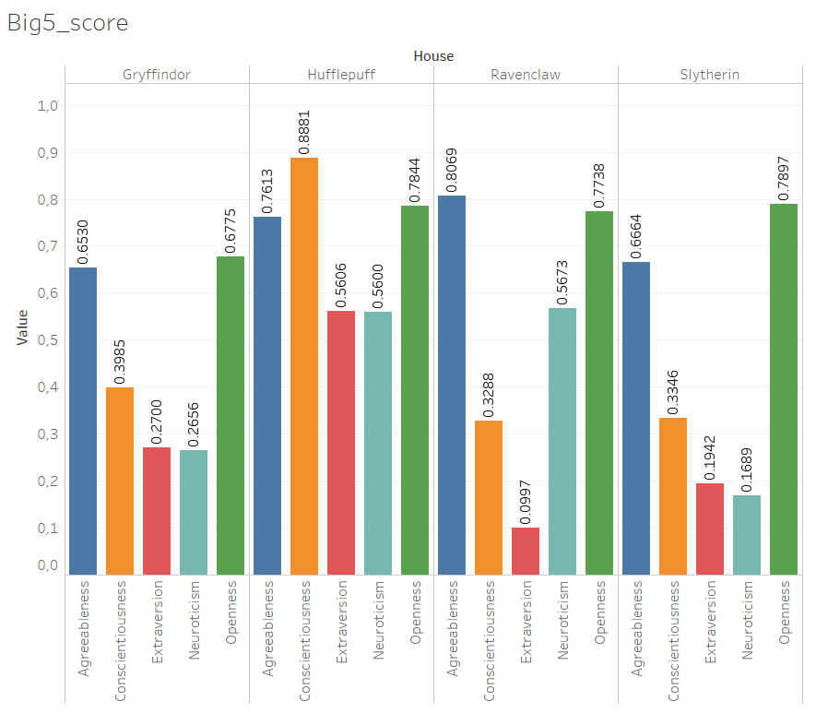
Avg : 0.888
Avg : 0.431
BIG5
Avg : 0.453
Avg : 0.515
Notes:
The Hufflepuff were leading the chart and slytherin somehow managed to find the last spot here as well. Then I thought this is me bringing data to the magic world why not

Slide 18

BRING MAGIC
TO
THE REAL WORLD

Slide 19
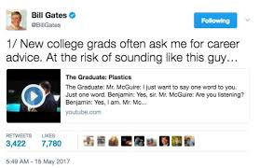
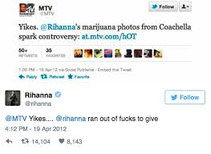
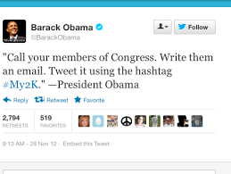
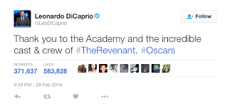
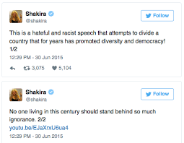
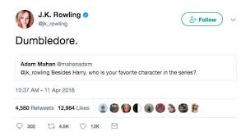
10 CELEBRITIES
Notes:
I choose 10 celebrities and based on what they post on the twitter managed to get their big5 score. So that I can sort them in Hogwarts houses. I choose celebrities from different areas so that it gives me a varity on the big5 score. These celebrities with their big 5 scores are

Slide 20

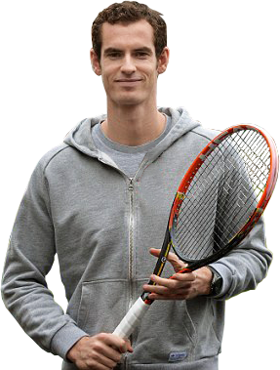
RAFAEL NADAL : 0.2818
ANDY MURRAY : 0.2836
Notes:
From lawn tennis

Slide 21
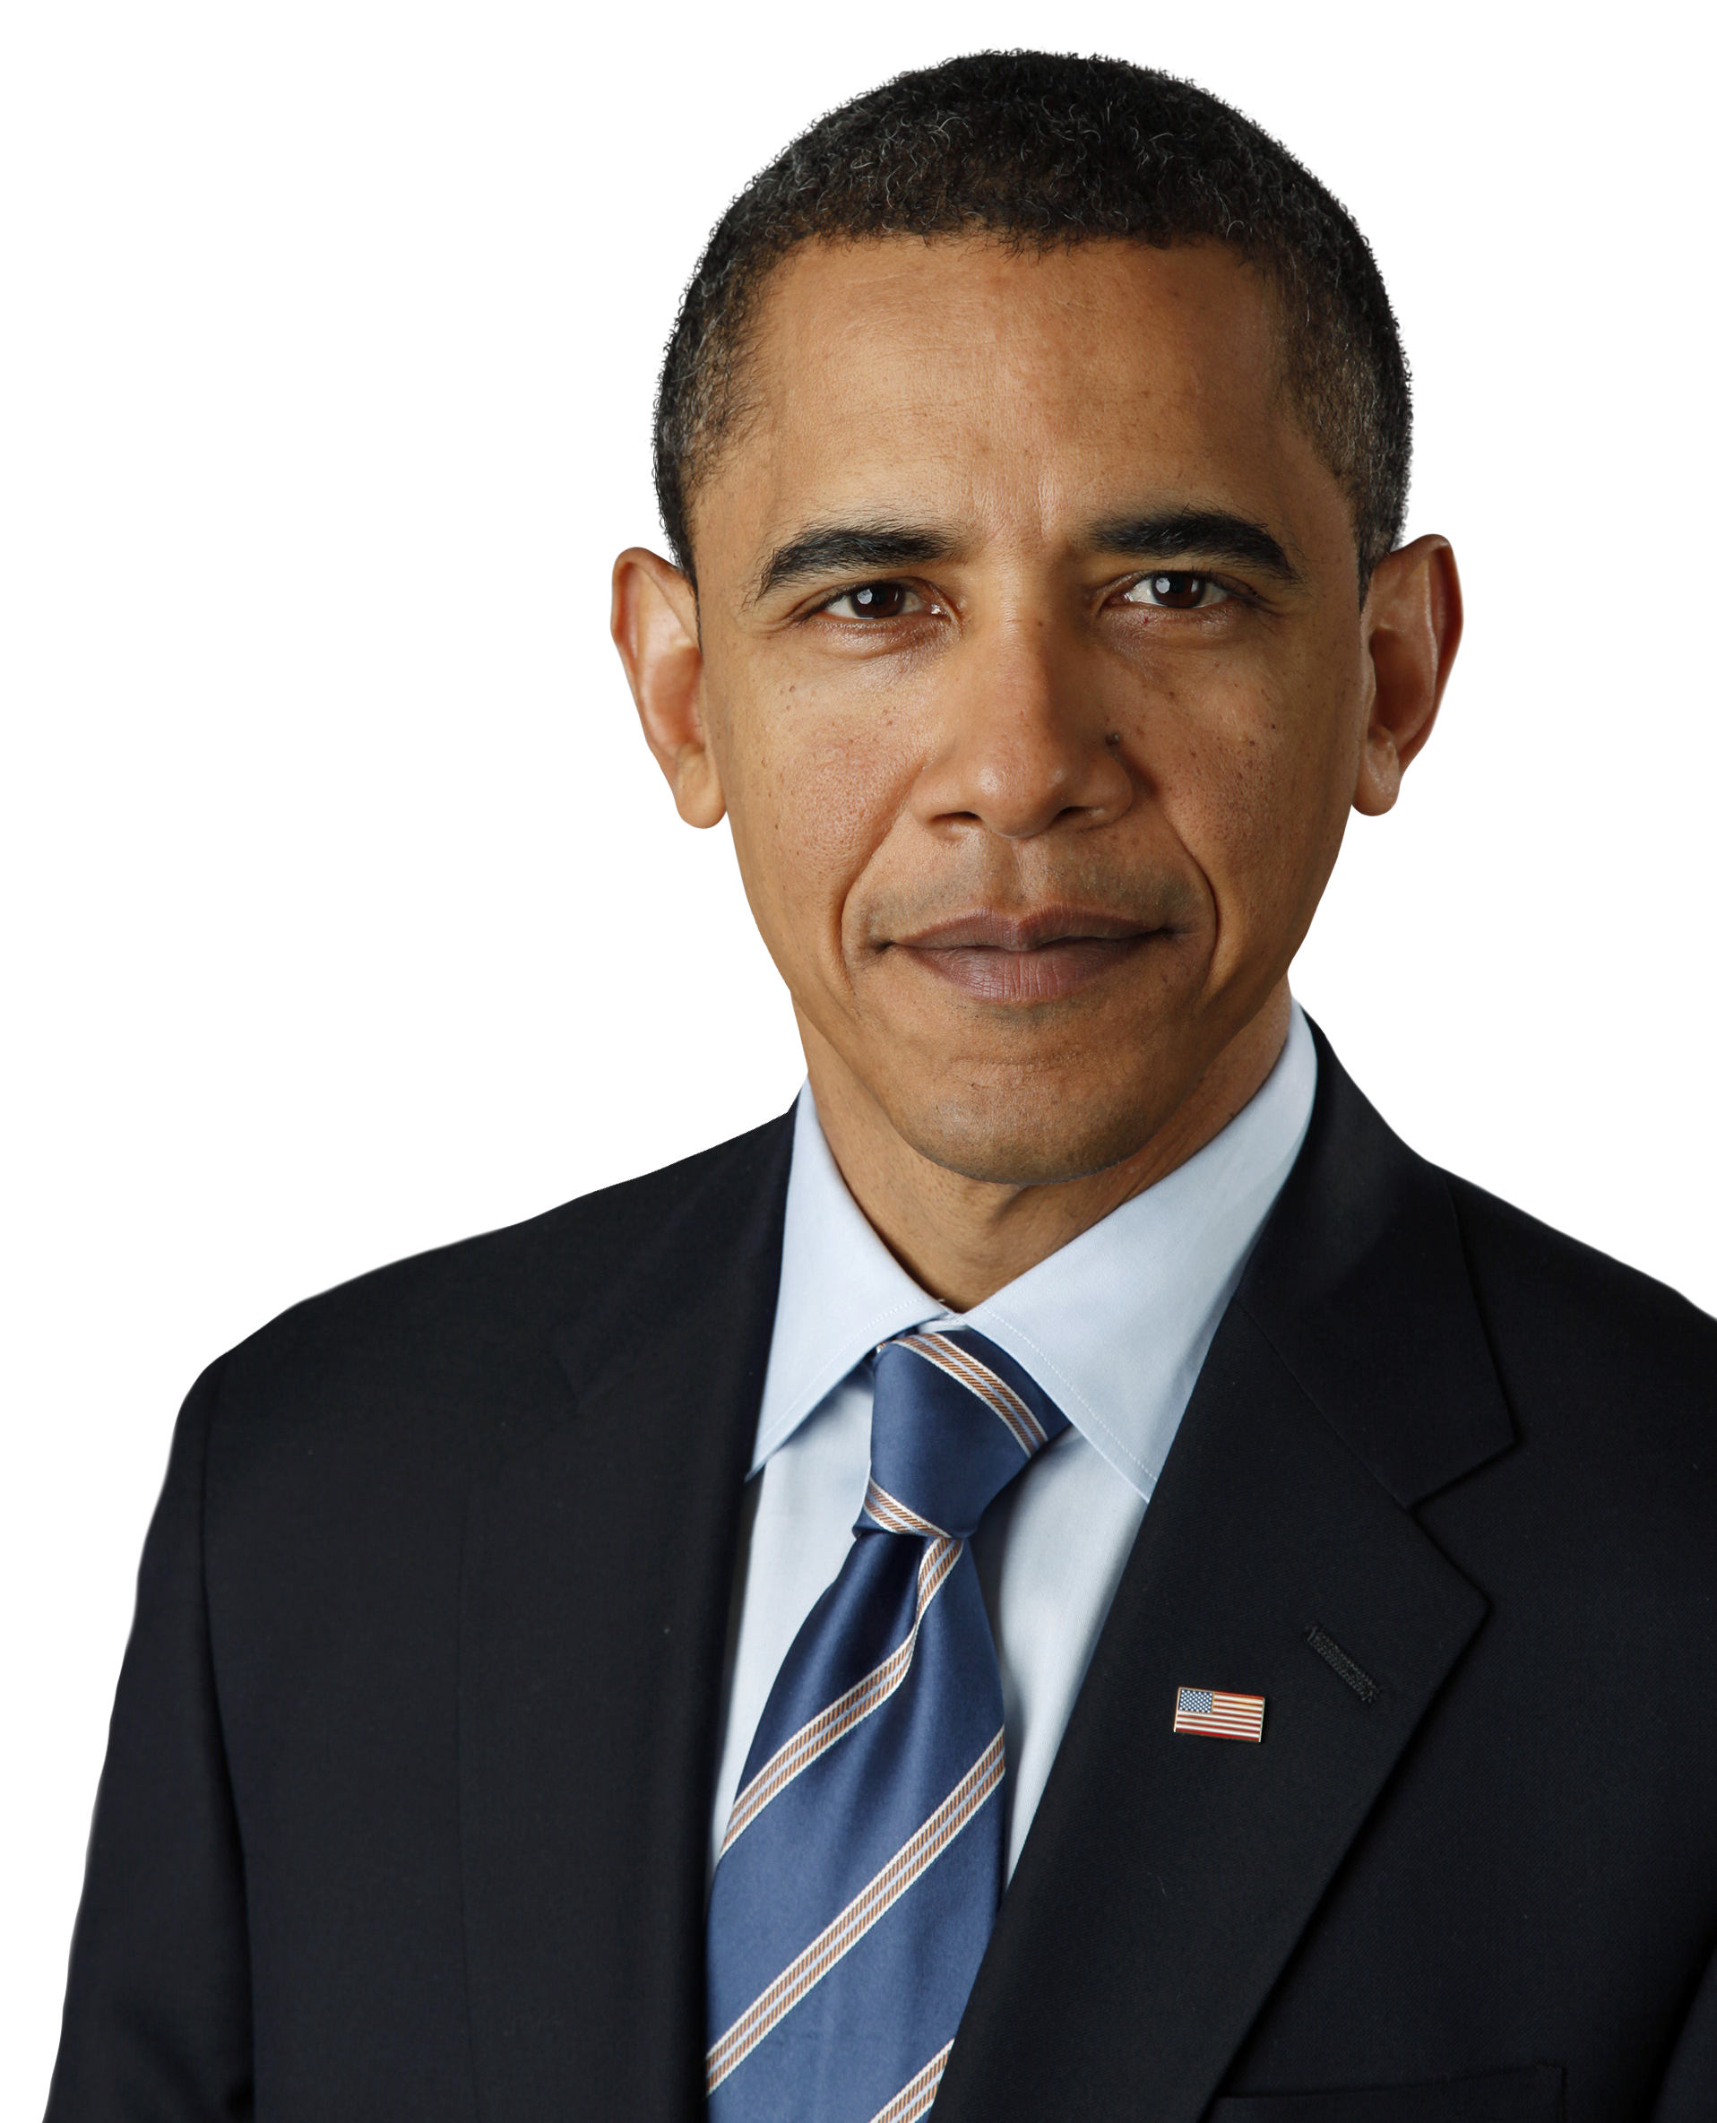
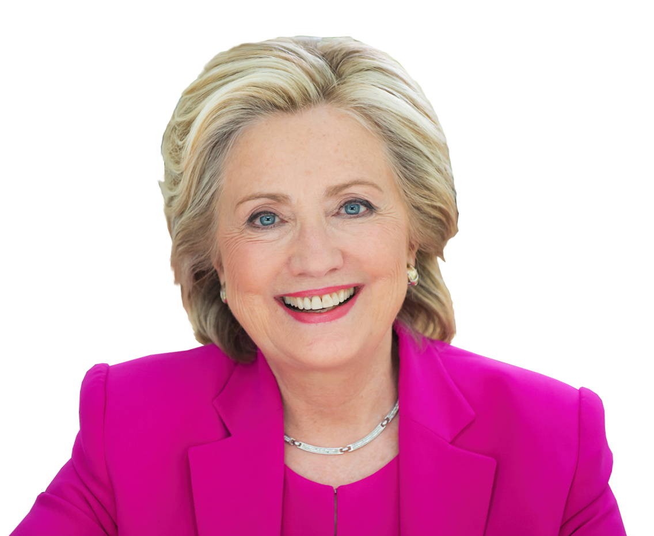
HILLARY CLINTON : 0.2539
BARACK OBAMA : 0.2716
Notes:
From politics

Slide 22
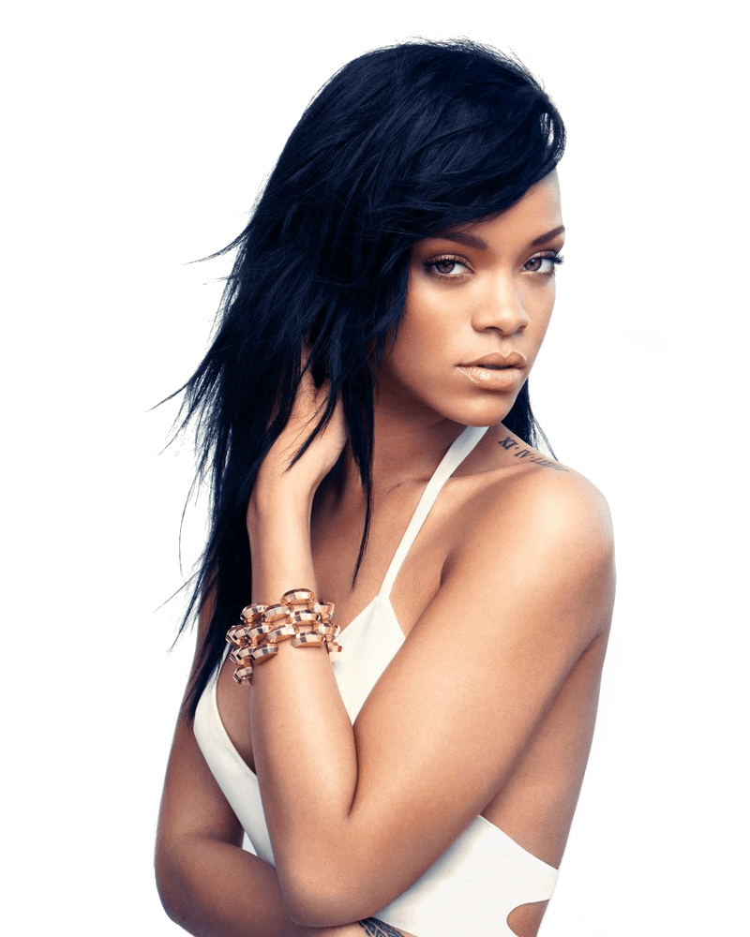
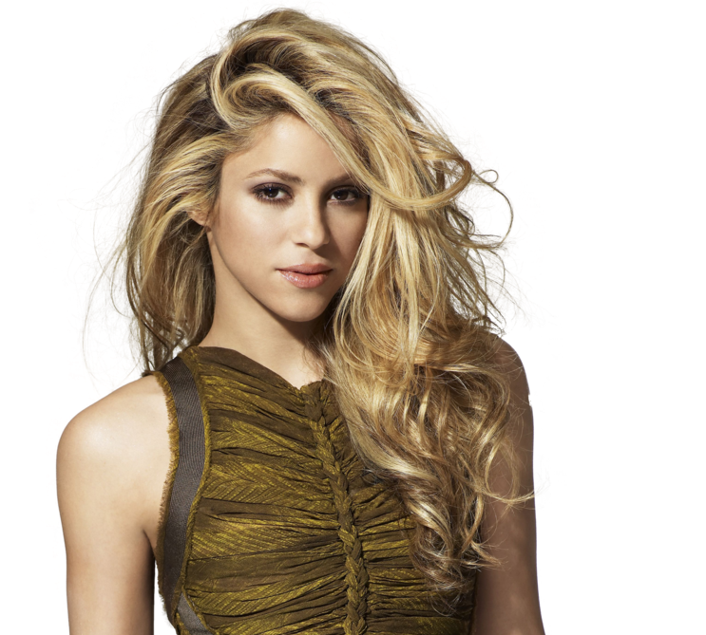
RIHANNA : 0.2692
SHAKIRA :0.3019
Notes:
Both artist

Slide 23
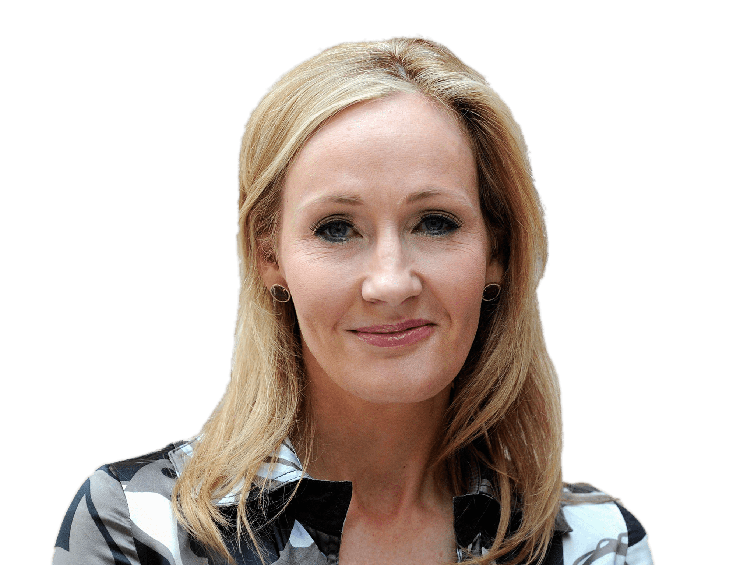
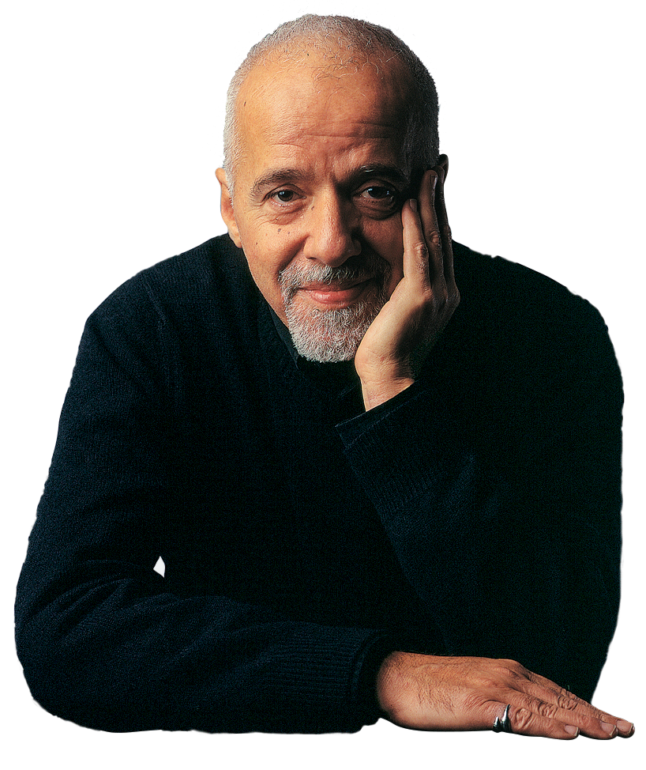
J K ROWLING : 0.2761
PAULO COELHO : 0.2952
Notes:
Both talented authors

Slide 24
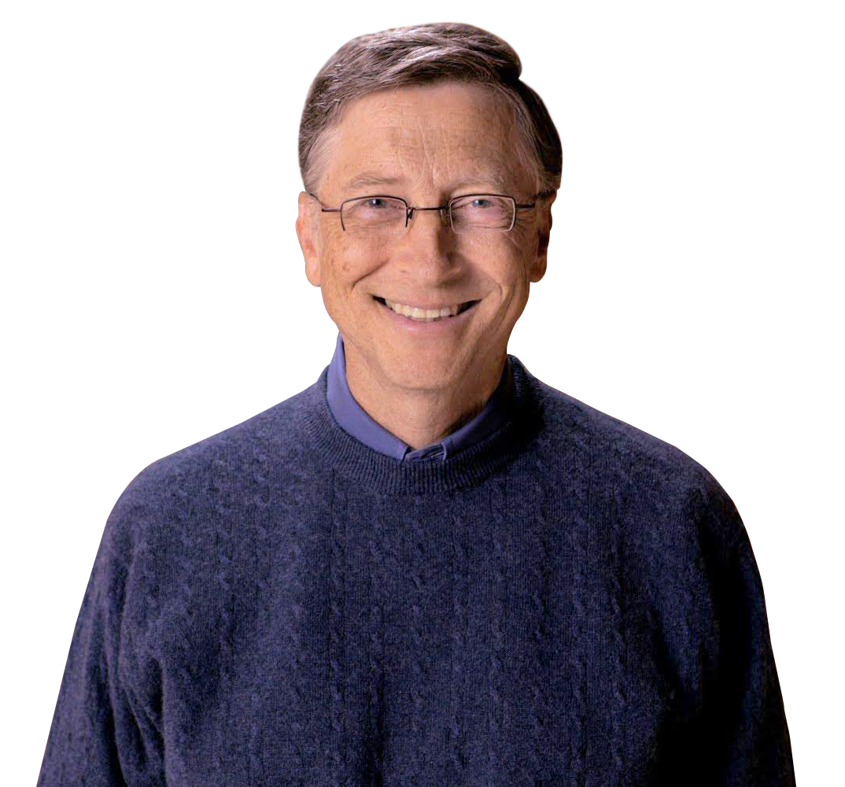
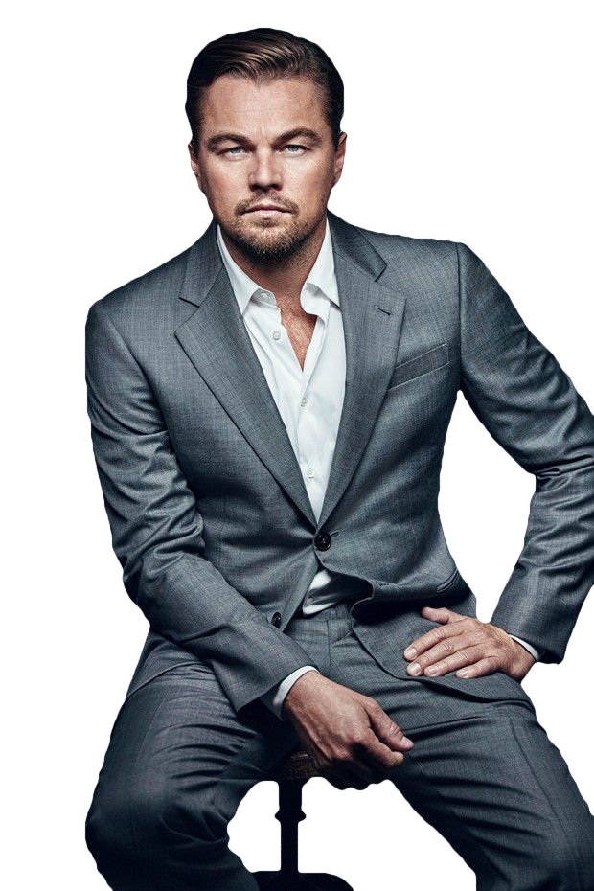
BILL GATES : 0.2879
LEO DI CAPRIO : 0.2839
Notes:
And lastly my two sweet hearts Bill gates and Leonardo di caprio because they are so rich and guess what

Slide 25

HOGWARTS
CONFIDENCE INTERVAL : 0.381 – 0.77
Notes:
None of them get admission to Hogwarts as no one falls in the confidence interval of big5 scores of the four houses. But essentially from this sad news I got some takeaways they are

Slide 26
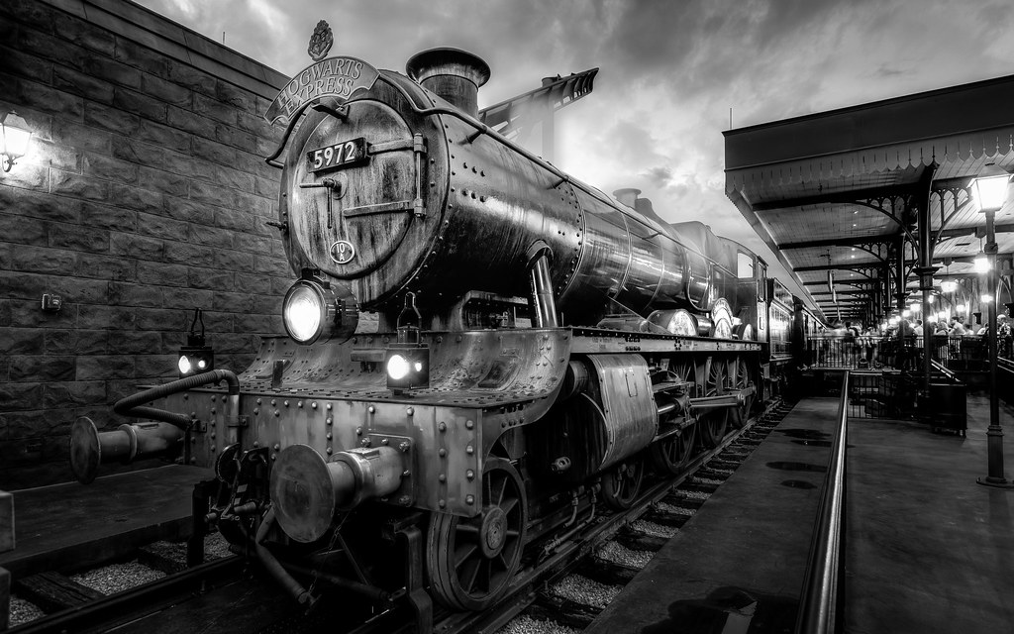
TAKEAWAYS
Sample size was small
Gryffindor people talk a lot
Just Big5 does not reveal the total personality
DON’T LOSE HOPE
Notes:
As small as 40 that’s why the results may have margin of error.
Since Gryffindors are the main characters they talk a lot and that’s why most of my sample consisted of far more Gryffindors than other house.
Also Just Big5 doesnot reveal the total personality We need to consider the other two aspect to get the total personality reading.
That’s why do not lose hope , your Hogwarts letter may be around corner. Remenmber

Slide 27
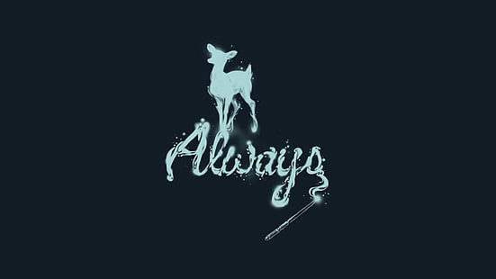
Notes:
Always harry potter.

Slide 28
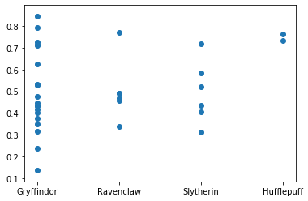

Slide 29
VALUES
CONSERVATION
HEDONISM
OPENESS TO CHANGE
SELF TRANSCEDENCE

Slide 30
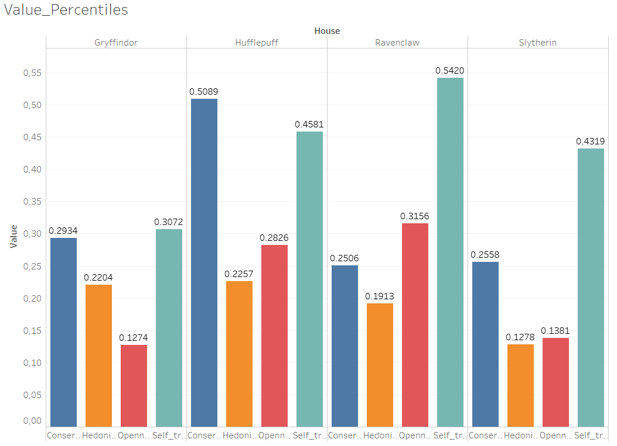
VALUES

Slide 31
NEEDS
CHALLENGE
CLOSENESS
STRUCTURE
CURIOSITY
EXCITEMENT
HARMONY
IDEAL
LIBERTY
LOVE
PRACTICALITY
SELF-EXPRESSION
STABILITY

Slide 32
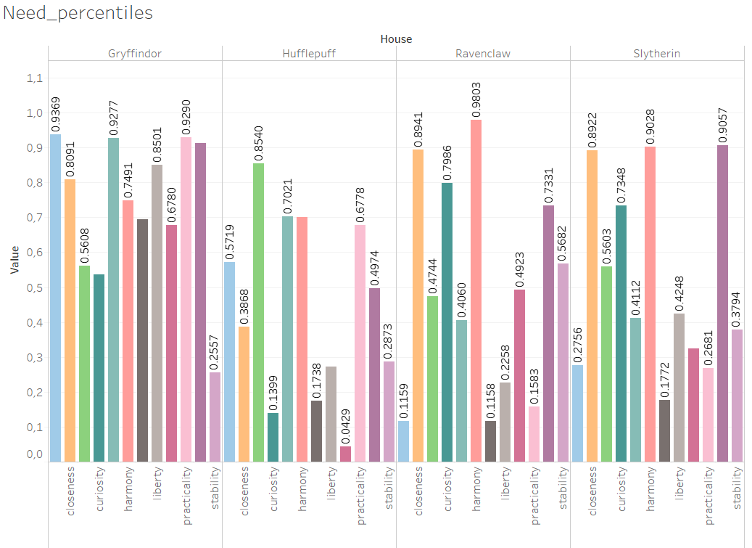

Slide 33
CHALLENGE
IDEAL
CLOSENESS
LIBERTY
STRUCTURE
LOVE
CURIOSITY
STABILITY
EXCITEMENT
PRACTICALITY
HARMONY
SELF-EXPRESSION

